Slide 1
Workshop 3:
Advanced Javascript
By Jolene | Sharina

Slide 2
Pre-Event Preparations
Code Editor/IDE
Atom
VS Code
These slides/code for your reference:
https://github.com/nyp-lit/webdevhackathon2022
Notes:
Send into the chat:
here’s the link to all workshop materials: https://github.com/nyp-lit/webdevcourse2022
We will be covering topics not learnt in school, so if any of you have any questions at any point of the workshop, you can drop them in the chat or discord channel

Slide 3

Contents
1
Photo-taking + briefing
Sets and .map
Type conversion and Arrow syntax
Callbacks and Promises
Asnyc await and using APIs
Quiz (?)
Attendance & Feedback Form

Slide 4
Type conversion and Arrow syntax

Slide 5
Type Conversion
What is type conversion and why is it important?
Type conversion is the process of converting data of 1 type to another
When operands or a function parameter is not an expected data type, error may occur in the code
Implicit and Explicit Type Conversions
Implicit Type Conversions
Explicit Type Conversions
Automatically converted by Javascript
Converted by the use of a Javascript function, manually typed by the Programmer
Notes:
There are 2 kinds of type conversion, implicit and explicit. Implicit type conversion is when the programmer does not need to convert the data type themselves because Javascript converts the value to the expected type following specific rules. One example of implicit type conversion is the alert function as it automatically converts any value to a string to show it. On the other hand,

Slide 6
Converting Strings to Numbers
Using Number()
Converts strings containing numbers to numbers (Eg. converts “1” to 1)
Converts empty strings to 0
Converts any other value to NaN (Not a Number)
Using parseFloat()
Parses a string and returns a float
Unlike Number(), allows spaces in the string. However, only the 1st number is returned
Notes:
There are 4 ways to convert strings to numbers. The 1st way is using the Number() method.
NaN (Not a number) - Returned if the value cannot be converted into a number
Difference between number() and parseFloat() - Number() will record strings containing numbers with spaces as NaN (Eg. “10 6”/”10 hours” to NaN) whereas parseFloat() is (“10 6” -> 10 and “10 hours” to 10)
Empty strings for parseFloat() return NaN

Slide 7
Converting Strings to Numbers
Using parseInt()
Parses a string and returns an integer
Unlike Number(), allows spaces in the string. However, only the 1st number is returned
Using Unary + Operator
Converts a variable to a number
Eg. let x = “12”; let y = + x;
Notes:
Note that decimal points will be rounded off to the nearest whole number for parseint()
(Unlike parseFloat() decimal numbers will be returned as is)
Empty strings for parseInt() return NaN

Slide 8
Converting Booleans to Numbers
Using Number()
Converts boolean to numbers
Eg. number(false) //Returns 0 number(true) //Returns 1

Slide 9
Converting Numbers/Boolean to Strings
Using String()
Eg. //For numbers String(22) //Returns “22” //For booleans String(false) //Returns “false”
Using toString()
Eg. //For numbers 22.toString() //Returns “22” //For booleans false.toString() //Returns “false”

Slide 10
Converting Numbers/Strings to Booleans
Using Boolean()
Values like 0, an empty string, null, undefined, and NaN become false
Other values become true
Notes:
A boolean only return false if it is an empty string ““ or the number 0. If it is a 0 as a string (“0”), it will return true

Slide 11
Other useful functions/operators
typeof
toFixed()
toPrecision()
Finds the data type of a Javascript variable
Eg. typeof “hi” //returns “string”
Returns a string, with a number rounded and written with a specified number of decimals
Returns a string, with a number written with a specified length
Notes:
Some other useful functions and operators related to type conversion are typeof, toFixed() and toPrecision(). The typeof operator is able to return the datatype of a Javascript variable. So like in the example, if you were to write typeof followed by a string, it would return “string”. This is useful when you want to check for a possible type error in your code, that may prevent the code from executing properly.
ToFixed() function is useful when a certain decimal place is required, such as when dealing with money

Slide 12
Arrow Function
What is an Arrow Function?
Constructing an arrow function
Introduced in ES6
Allows programmer to write shorter function syntax
Given a traditional function: function (x) { return x + 10; } 1. Remove the word “function” and place arrow between argument and opening body bracket 2. Remove body braces and word “return” (Return is implied) 3. Remove the argument parentheses Arrow function: x => x + 10;
Notes:
Now moving on to arrow functions. The purpose of arrow function is to be able to write functions in a more convenient manner.

Slide 13
However, in some cases, the {braces}, (parentheses) and “return”, are required
If there are multiple arguments/no arguments: - Parentheses is needed Eg. Traditional function: function (x, y) { return x * y; } Arrow function: (x, y) => x * y;
If the body requires additional lines of processing - Braces and “return” are needed Eg. Traditional function: function (x, y) { x = 4; y =5; return x * y; } Arrow function: (x, y) => { x = 4; y =5; return x * y;}

Slide 14
For named functions, arrow functions are treated like variables
Eg. Traditional function function addition (x) { return x + 10; }
Arrow function let addition = x => x + 10;

Slide 15
Maps and Sets

Slide 16
Maps and Sets
What are maps and sets?
Maps
A collection of key-value pairs
Remembers the original insertion order of the keys
Sets
A collection of unique values
Each value can only occur once in a Set
Notes:
The main difference between maps and sets is that sets do not have key values

Slide 17
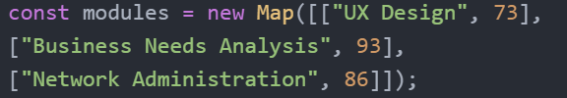
Methods: Maps
new Map()
set()
get()
Creates a new Map
Sets the value for a key in a Map
Can be used to add a key-pair value or to change existing Map values
Returns the value for a key in a Map
Notes:
2 ways to create a Map: Pass an Array to new Map() constructor or Create a Map and use Map.set()
set() method: map.set(key, value)

Slide 18
Methods: Sets
new Set()
add()
Creates a new Set
Adds a new element to the Set
If the same value is added more than once, only 1 occurrence of the value will be saved
Eg.
Notes:
2 ways to create a Map: Pass an Array to new Set() constructor or Create a Set and use Set.add() to add values/variables to the set

Slide 19
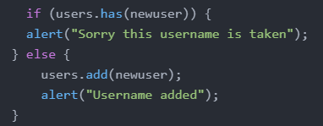
Methods: Maps and Sets
has()
delete()
Returns true if a key exists (for Maps)
Returns true if a value exists (for Sets)
Removes an element from a set
For Maps:
The element to be removed is specified by its key
For Sets:
The element to be removed is specified by its value
Notes:
For maps, the has() method returns true if a key exists in the map. However for sets, a set has no keys, so it returns true if a value exists in the set.

Slide 20
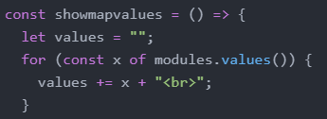
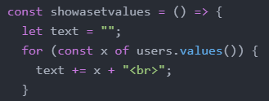
Methods: Maps and Sets
values()
Implementation using Maps:
Implementation using Sets:

Slide 21
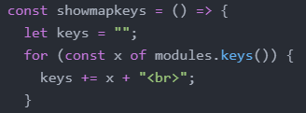
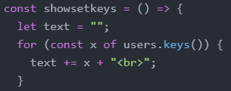
Methods: Maps and Sets
keys()
Implementation using Maps:
Implementation using Sets:

Slide 22
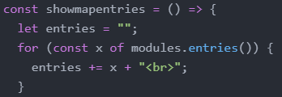
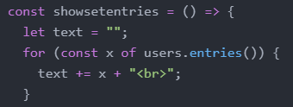
Methods: Maps and Sets
entries()
Implementation using Maps:
Implementation using Sets:

Slide 23
Methods: Maps and Sets
clear()
forEach()
Removes all elements from the Map/Set
Invokes a callback for each element

Slide 24
Callbacks, Async Await and Promises

Slide 25
What is Asynchronous Programming?
While making requests to servers elsewhere, and we don’t want the program to wait and freeze.
One code block runs asynchronously means that the code runs on its own time while other code is running synchronously.
Callbacks were used until ES6 was released in 2015 where Promises were introduced. Finally, in ES7 Async Await was introduced.
Notes:
Normally, a given program's code, only one thing happening at once. So like it goes through each line of the code one by one. If let’s say one line takes a significant amount of time to get smth done the program will appear frozen. If a function relies on the result of another function, it has to wait for the other function to finish and return, and until that happens, the entire program is essentially stopped from the perspective of the user.
What we are trying to get over here is to make sure that our program can still do other things while its fetching data for example instead of being frozen. For example, when you press buttons on a page its fetching data but when it does that you still want to be able to do other things. If its hard to understand it not it might be easier in the next slide.
For Javascript specifically we have callbacks async await and promises that help with async programming
In react theres things like useeffect which are also asynchronous and how you do API calls

Slide 26
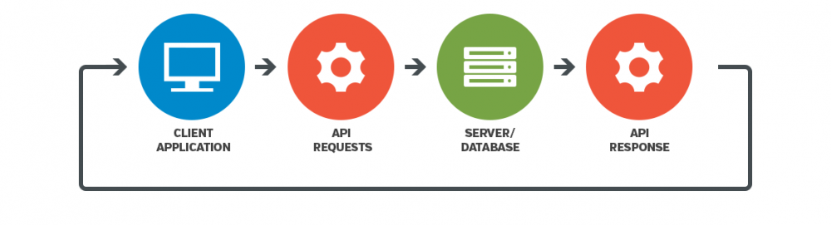
The need for Asnyc Programming
Notes:
You might have seen this slide before from previous workshops but i will be using it again to explain the need for async programming. From the client side application we make API calls to the server/database and it might take some time to get the response. In that time we don’t the program to freeze.

Slide 27
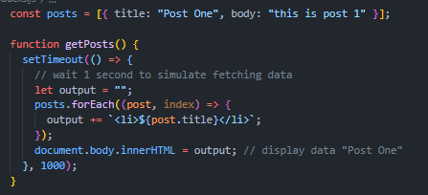
Callbacks
Let’s simulate fetching data from a database with the function getPosts() using setTimeout to make the function wait a second before running it.
Notes:
Let’s simulate fetching data from a database with the function getPosts() using setTimeout to make the function wait a second before running it to simulate fetching data from a server/database
For each post as we defined in the constant variable posts which is a list of dictionaries, we will display the title meaning “post one” for example. What i mean by display is that html for the list is created and then loaded onto the screen. So since theres only 1 post to loop through at forEach the function only creates one list element and inserts it into the body
So as of now there’s still no use of callbacks

Slide 28
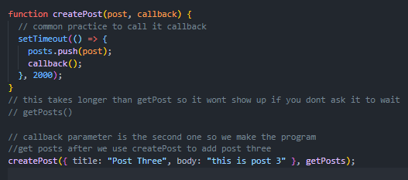

Callbacks
What if we want to create posts? Since DOM is already loaded at 1s, adding this data into our array at 2s will not allow it to show up in the browser.
Notes:
Now let’s create a new function createPost() that takes in 2 parameters post and callback, you can actly name callback whatever you want but its common practice to name it callback
So now we’re going to make createPost() take longer than getPosts() this means get post loads first and results in “post one” in the browser but not post 3 since it wasnt added yet and when post 3 is finally added at 2s we arnt funning createpost again so it wouldnt load up on the bowser. One way we can get over this is to ensure that getpost waits for createpost to finish before getpost runs meaning we will create post 3 before we get all posts.
So we use the callback in the parameter as a function which will happen after pushing the post. So when you use createpost you have to give it what you want to create and the function to run after. (go thru how to code works as a whole)
Ok so this part is gna b harder to follow along so is everyone following?

Slide 29
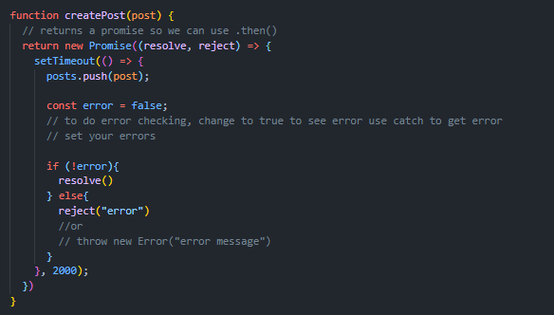
Promises
The getPosts() function remains the same but we will rewrite createPost. The most useful part of promises would be Promises.All but we will first take a look at how to write promises.
Notes:
Basically it does the same thing but Instead of passing in a callback function in the parameter like callbacks we will return a new promise which a function that has 2 parameters resolve and reject where resolve means theres no error and reject means there was an error. Here you would be able to define errors and write error messages for the error like reject() or throw new Error()
The const error = false part is to simulate when something goes wrong and you want to catch that error. With this then you’re able to add .then and .catch which we will see how to use in the next slide in order to catch errors and run things asynchronously
Usually you’ll see the .then .catch thing more than these promises cuz we use the API and the API is built with these promises to be able to return errors etc.

Slide 30

Promises: then and catch
.then is used to define the function you want to call next
.catch is used to catch all errors returned by your promise

Slide 31
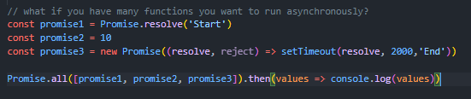
Promises: Promise.All
We want to run promise 1 followed by 2 and 3. All we need to do is use Promise.all([promise1, promise2, promise3]).
Don’t forget .then to print values or it would just run. You can also include .catch to catch errors again too.
Notes:
// add explanation here

Slide 32
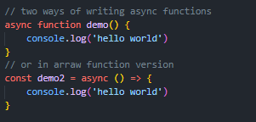
Async Await
2 ways of writing Asnyc Await, one is using older way of defining functions that you’re likely used to and the other is arrow functions in ES6.
Notes:
Where you can just define async before your brackets

Slide 33

Async Await
Async Await is another way to write callbacks and .then.catch with promises, a much more elegant way.
“await “ keyword means wait for createPost to finish before continuing to getPosts()

Slide 34
Using APIs
Notes:
Now that we know what Asynchronous programming is about, lets try applying what we’ve learnt with the use of APIs to access databases from our client side website.

Slide 35
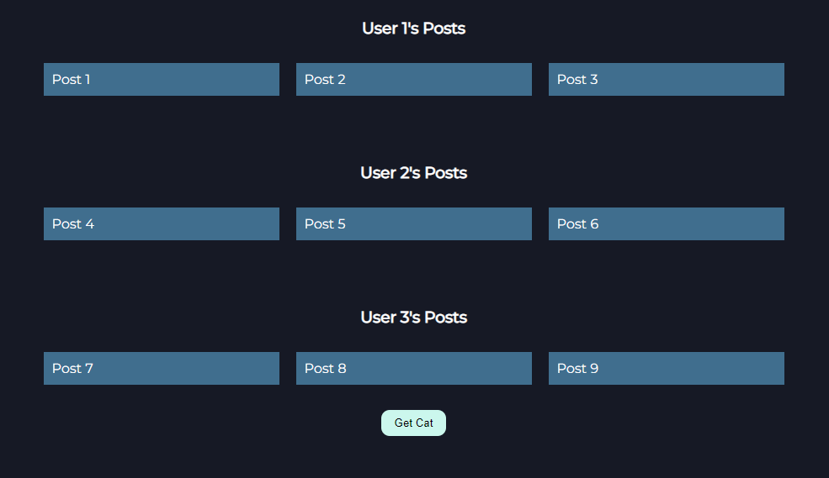
Application of Async Programming
We will be using Asnyc Await and an API for this practical
All posts pulled from data/user.json file using async await.
“Get Cat” button demonstrates using third party APIs.
Notes:
We will use a public API that doesnt need authentication so its easier for us to work with it but i will show you how to store API keys and how that all works
[go over to code n teach]
Let us know by typing yes in the chat if you managed to download it, cuz u will need the json file to be able to run it. For this part i’ll be walking thru the practical with everyone bcs async programming might be a newer topic for some
https://marketplace.visualstudio.com/items?itemName=ritwickdey.LiveServer for live server plugin or cn js open the index.html file

Slide 36
Free Public APIs you can use
Looking to use API’s for the hackathon? Here’s a few to make your website more interactive!
https://github.com/public-apis/public-apis
https://github.com/public-api-lists/public-api-lists
https://docs.github.com/en/rest
https://rapidapi.com/hub
https://developers.notion.com/reference/capabilities
Notes:
You might be looking for some free public APIs to work with for the hackathon to make your site more interactive so here are some good resources! The first 2 are popular lists for public APIs and there’s also the github API or rapidAPI which has many APIs though some are not free and also notion’s API which if you’re familiar with notion it can do quite a lot. There are many other free public APIs out there which you could use with your own website so you maybe start looking and companies you know and seeing if they have APIs.

Slide 37
Quiz Time

Slide 38
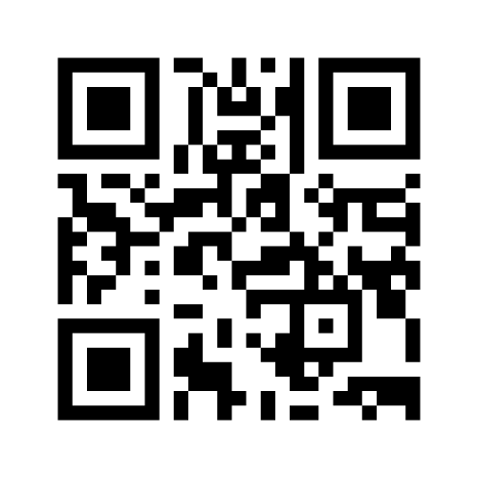
Menti Link:
https://www.menti.com/u1wxszn5gi

Slide 39


Thank you!
Do you have any questions?
Hop over to the get-support voice channel! We will be there till the end of the event, or feel free to drop us a message in get-support text channel
https://nyp-lit.github.io/
@nyp_lit

